Slide 1
Excellence in Education
Tips and hints for preparing a successful application
Janelle Taylor,
Coordinator of Graduate Student and Research Affairs
Graduate Studies and Research

Slide 2
Excellence in Education
The Excellence in Education Program is a $1500 award established to support graduate student research in the summer. The awards are intended to assist graduate students in the conduct of scholarly research and creative works that will enhance their academic experience and professional growth. Recipients of this grant will also receive a one-credit tuition stipend to enroll in a course directly related to their research during one of the two summer sessions.

Slide 3
Basics - Eligibility
You are eligible to apply for this award if…
You are a graduate student at NMU
Have academic good standing
Are not using the NMU Dependent Child Tuition Waiver

Slide 4
Basics - Fundable v. Non-fundable
You can use this money for...
Activities that your department defines as “scholarly or creative work”
Activities that result in a tangible product
Funds related to supplies, materials, travel, living expenses, or other activities directly associated with your proposed project
Expenses incurred while traveling to scholarly meetings where you’re presenting a paper or creative exhibit (but prepare to provide proof that your paper/exhibit has been accepted at the time you’re applying)
But not for...
Activities that you’d do as part of your normal job
Attending a conference without presenting your work
Payment for services rendered to a second party

Slide 5
Assemble your application like this:
Excellence in Education cover page*, signed by you, your advisor, and your department head
A 4-6 page narrative, double-spaced, in 12-pt. Times New Roman, including…
A statement of the problem, project objectives, significance
A brief discussion of the Project Rationale and a Literature Review
The project plan with a timetable with expected outcomes
Statement of resource availability (supplies, equipment, staff)
Budget form* -- be clear about how you are spending the money and where your numbers come from. It needs to make sense, but not be overly detailed.
Appendices
Your CV
Your transcript
Letter of support from your advisor
If applicable, copy of Final Report from previous EIEs
If applicable, documentation of IACUC/IRB application/approval

Slide 6
The Process
What the student must do:
Plan ahead! Get signatures from your faculty advisor* and department head before the deadline!
Submit a complete .pdf electronic application via e-mail to 1) their Department Head and 2) the Office of Graduate Education and Research (graduate@nmu.edu) by the deadline. The application must include a scanned copy of the signed cover sheet and completed budget form.
*Your advisor is the faculty member working on this project with you
Behind the scenes:
February: After the student submits the signed cover page with their application, department heads will be contacted to evaluate the proposals and rate them as excellent, very good, good, or fair, and departments with more than one student applying must also rank their applicants. Additional comments can be attached in the form of a letter.
March: The ranked applications are reviewed and awards are determined by the Graduate Programs Committee
End of March: Awards will be announced. (Watch your email!)

Slide 7
Cover Letter Electronic Option
We can help you get signatures on your cover sheet electronically
If you would like your cover sheet electronically send out by Grad Studies:
Email the cover sheet to graduate@nmu.edu
In your email, include your name, and the names, email addresses, and titles of the people who need to sign your cover sheet
You must plan ahead if you want to use the signature option!

Slide 8
Evaluation: Quick Guide
The significance of the proposed project and soundness of the methodology.
Clarity of presentation and planning of the proposed project.
Qualifications of the student investigator.
Adherence to format and content requirements.
Justification of additional funding for second year applicants.

Slide 9
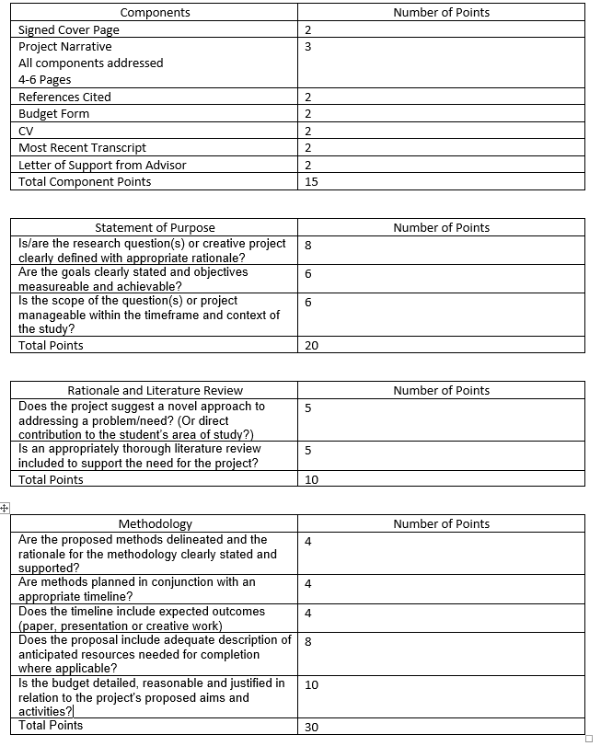
Scoring Rubric
Pay attention to detail!
Excellence in Education is set up like a grant - it is practice for grant writing on a bigger scale. Huge grants have been denied as a result of small errors.

Slide 10
Some things to think about
Remember: you must propose a project that you are able to do
Keep the pandemic in mind – we don’t know what the future holds, but plan for your project to be quarantine-friendly, or at least able to pivot to that if needed
Make sure the work can be done in the amount of time and with the resources you have
If you need to modify your project, you will need to submit the modification to the Graduate Programs Committee for approval (and that is not guaranteed)
Remember this involves a summer credit
Talk to your advisor now about what that summer credit will look like and if they are willing to teach it if you are planning to do a directed study or thesis/capstone credits

Slide 11
Deadline day:
By 11:59 p.m., your .pdf application must be submitted via email to graduate@nmu.edu, with your department head copied.
Your application should include four main components noted on the Excellence in Education Checklist (see your handout or the Grants and Contracts website under “Excellence in Education Research Program Guidelines.”)
https://www.nmu.edu/grantsandcontracts/excellence-education-research-program-guidelines

Slide 12
How do I put the documents in one PDF file?
You have options:
1: NMU has a institutional license to Adobe Acrobat. Ask at the HelpDesk and have it installed on your computer.
2: The library has resources for creating documents and scanning. Ask for Kevin McDonough. He knows everything.
3: Email/come to the Graduate Office and ask for help. We’re always willing to lend a hand, but will not reformat your submission or fix inaccuracies if you submit without asking for help.

Slide 13
Winning isn’t everything…
Winning an award is only the first step in a grant.
For the Excellence in Education, you must enroll in 1 credit over summer in a subject that is related to the topic of your project.
This is a covered part of your award.
At the end of your project you must submit a final report detailing what you did and how the money was spent
Get used to reports. All grants require them.

Slide 14
Final Reports
NMU’s final report asks 6 questions:
What was done? (Summarize the project activities.)
What were the results?
What was produced (publication, presentation, creative work, etc.)?
What further research might this lead to?
What sources of external grants did you (or might you) seek?
Detail the actual budget expenditures.
This is a short version of what bigger grants will ask for.
Some grants ask for progress reports as you go through the grant timeframe.
Due October 15
https://nmu.edu/sponsoredprograms/internal-grant-reporting

Slide 15
Other Research Funding
The Spooner Awards
Due in mid November every year
$500 – three awards available
Three Minute Thesis
Three minute presentation contest
Winners receive prize money
Graduate student winner participates in a regional competition with wide exposure
Mid February every year

Slide 16
Questions?
Contact info:
Janelle Taylor
Graduate Studies and Research
jantaylo@nmu.edu / graduate@nmu.edu
(906) 227-1407

