Slide 1
Academic Information Services Advisory Committee (AISAC)
Library and AIS Update
Report to NMU Faculty Senate
November 2, 2010
Bruce Sarjeant, chair, AISAC

Slide 2
Direction of the library is based on five strategic elements as identified by David Lewis (Dean of the IUPUI Libraries) and adjusted for NMU:
• Continue the migration from print to electronic collections and capture the efficiencies made possible by this change.
• Retire legacy print collections while maintaining disciplined-based core titles.
• Redevelop the library as the primary informal learning space on the campus.
• Reposition library expertise, resources, and information tools so they are embedded into the teaching, learning, and research enterprises.
• Migrate the focus of collections from purchasing materials to curating content.

Slide 4
Percent (%) Library Expenditures by Major Category

Slide 5
Consortial Purchases through MLCS
ABI/Inform (ProQuest) | Oxford English Dictionary (OED)
ACLS Humanities E-Book Project | Oxford Reference Online Premium
ACM Digital Library | Oxford Univ. Press Journals
ACS Archives | Philosopher's Index
ACS Web Editions | Project Muse
Agricola | PsycArticles
America: History & Life | PsycBooks
Biography Reference Bank | PsycInfo
Bowker's Books in Print | Reader's Guide Retrospective
Britannica Online | Sage eJournals Collections Plus
Cambridge Univ. Press Journals | Sociological Abstracts
CINAHL with Full Text | SPORTDiscus
CQ Researcher Online | SpringerLink Electronic Journals
CQ Weekly | STAT!Ref Medical
Europa World Year Book | Ulrich's Periodical Directory
MathSciNet | Wiley Online Library
MLA International Bibliography | And14 databases through Wilson
Naxos Music Library

Slide 6
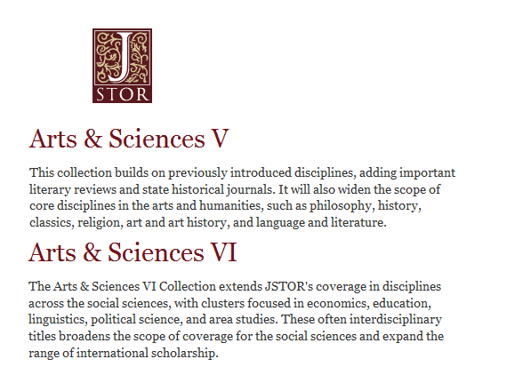

Slide 7
Michigan Electronic Libraries (MeL) Databases
Academic OneFile
ArticleFirst
Biography and Genealogy Master Index
Business & Company Resource Center
CAMIO: Catalog for Art Images Online
Computer Database
CRC Handbook of Chemistry and Physics
Educators Reference Complete
Gale Virtual Reference Library
General OneFile
Health & Wellness Resource Center
HeritageQuest Online
LegalTrac
MelCat
WorldCat

Slide 8
NMU Only Subscriptions
American Society for Microbiology Online Journals | Literature Resource Center
Access World News | Mental Measurements Yearbook
ARTstor | Nature Journals Online
BioOne | New York Times full image ed.
Birds of North America | NewsFile collection / InfoWeb
Books24x7 | Pro and Con Online
Cabell's Directories of Publishing Opportunities | PROLA American Physical Society
Cambridge Journals Online | Royal Society of Chemistry Journals Archive
Choice Reviews Online | ScienceDirect
Cochrane Library | Science Direct individual subscriptions: Methods In Enzymology, Lancet, American Journal of Human Genetics
CRC Handbook of Chem & Phys | Science Online
E-Duke Scholarly Collection | Westlaw Campus Research
GVRL | Wildlife & Ecology Studies Worldwide
Hoover's [ProQuest ABI/Inform] | World Shakespeare Bibliography
JSTOR

Slide 9
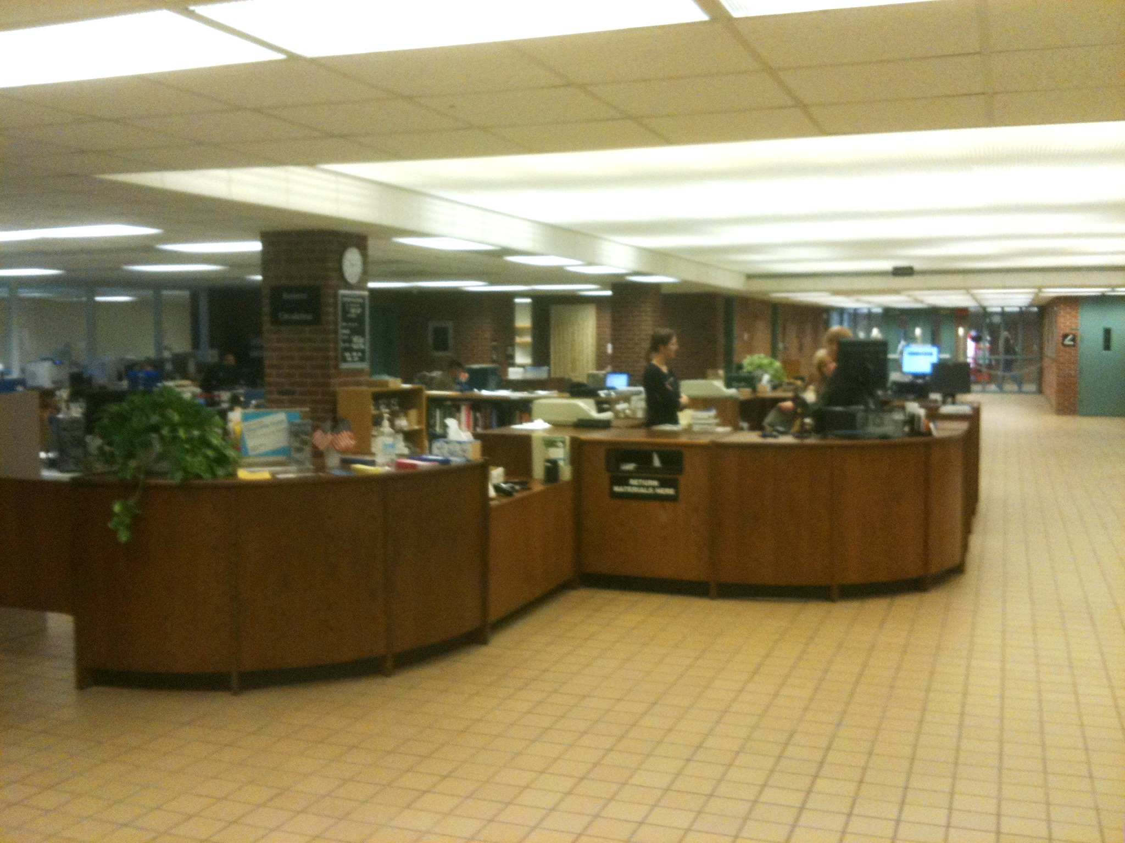

Slide 10
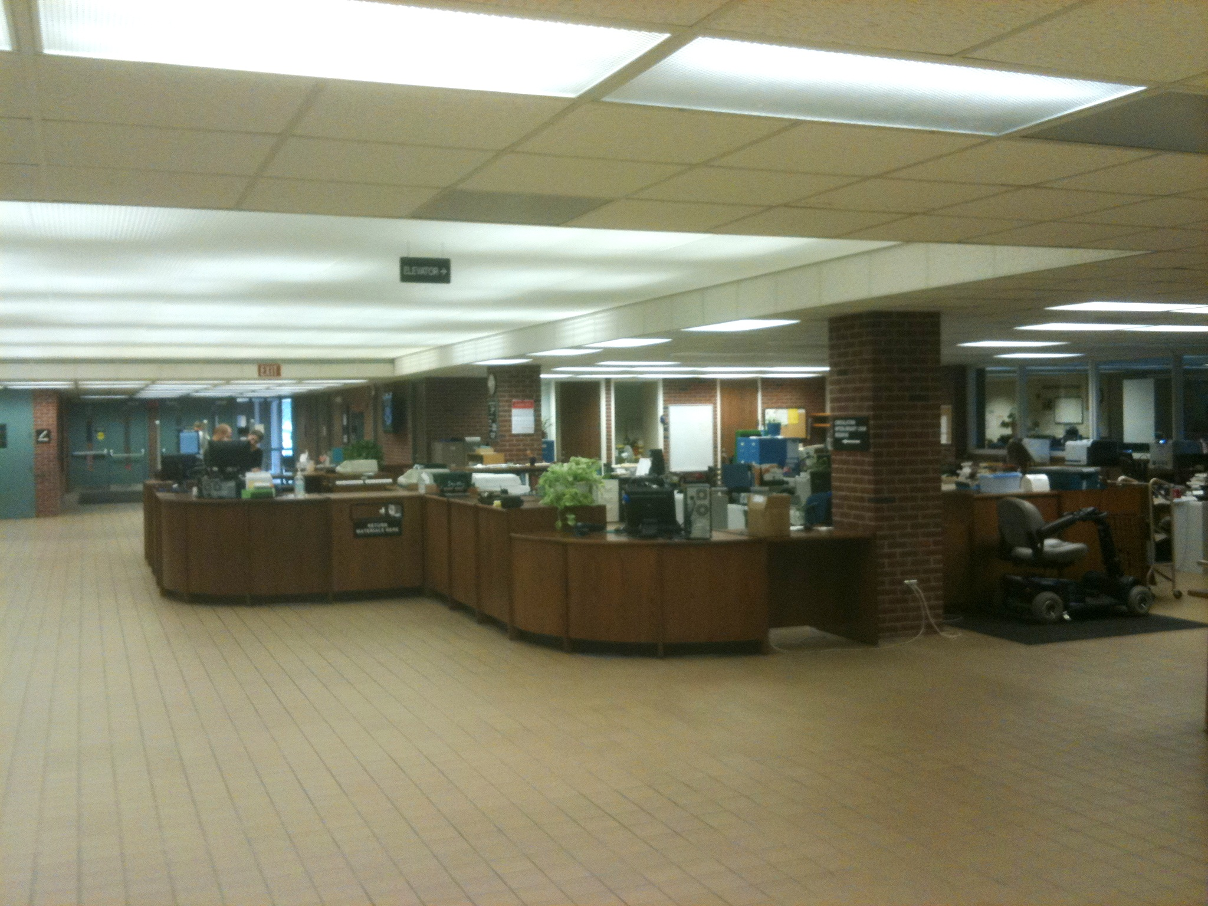

Slide 11
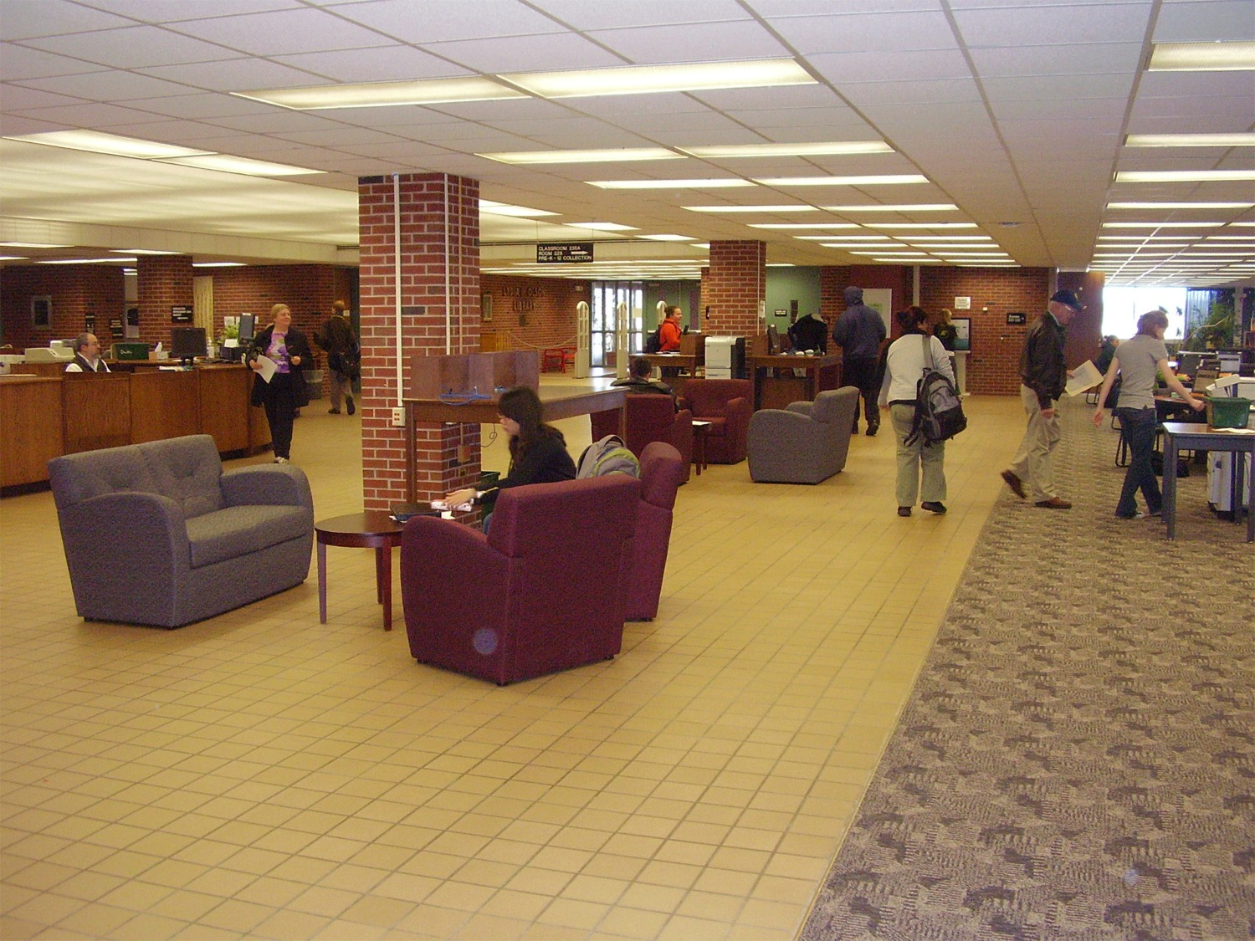

Slide 12
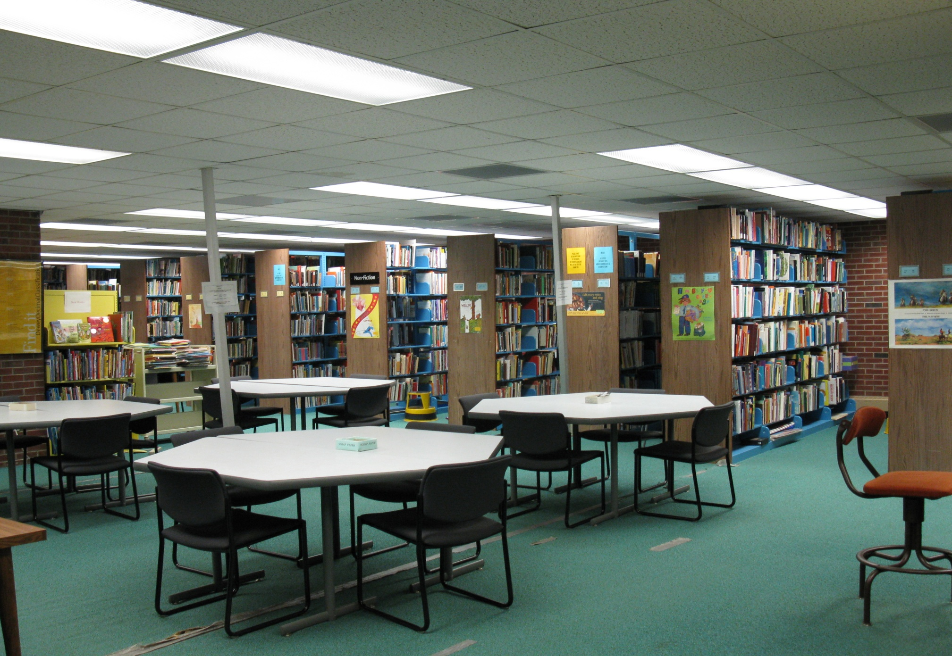

Slide 13
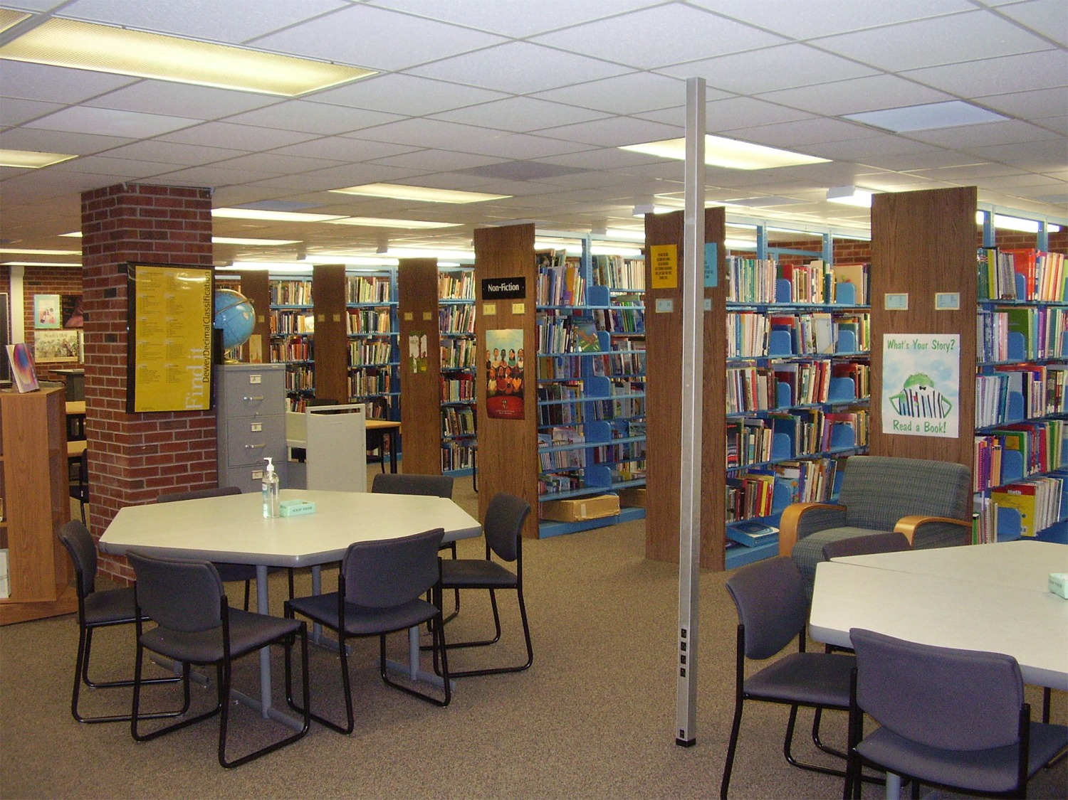

Slide 14
NMU was one of 25 schools that participated in the Spring 2010 Survey.

Slide 15
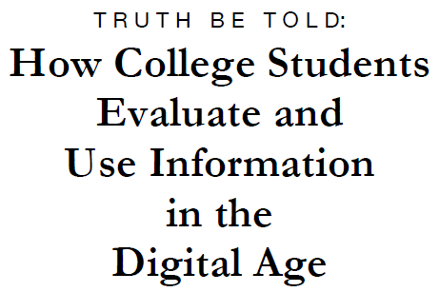
http://projectinfolit.org/pdfs/PIL_Fall2010_Survey_FullReport1.pdf

