Slide 1
College of Health Sciences and Professional Studies
Presentation to EPC
March 13, 2017

Slide 2
Mission Statement
The programs within the College of Health Sciences and Professional Studies provide students and faculty the opportunity to think independently and critically and to apply the professional knowledge, skills, attitudes and behaviors needed to serve their communities of engagement.

Slide 3
Composition of CHSPS
Four schools (Nursing, CS, HHP, Ed)
Four departments (CJ, SW, Eng Tech, Military Science)
TOS removed and became own college in Fall 2016
One center (Seaborg Center)
NMU Counseling Center
NMU Police Academy

Slide 4
Majors
School of Clinical Sciences
Clinical Lab Sciences (six concentrations)
Clinical Health Science
Speech, Language and Hearing Sciences
Clinical Molecular Genetics (MS)
School of Nursing:
Nursing (BSN)
RN to BSN
Doctor of Nursing Practice (DNP)

Slide 5
Majors
School of Health and Human Performance
Athletic Training
Management of Health and Fitness
Community Health Education
Outdoor Recreation Leadership and Management
Sports Science
Physical Education (Coaching and Secondary Ed)
Exercise Science (MS)
School of Education, Leadership and Public Service
Elementary Education (5 concentrations/ 7 minors)
Secondary Education (17 concentrations / 16 minors)
M.A. in Education
Education Specialist

Slide 6
Majors
Engineering Tech
Electrical Engineering Technology
Industrial Technologies
Mechanical Engineering Technologies
Secondary Ed Industrial Technologies
Social Work
Social Work
Criminal Justice
Loss Prevention (Global Campus Program)
Criminal Justice

Slide 7
Accreditations
Athletic Training Education accredited by the Commission on Accreditation of Allied Health Education Program (CAAHEP)
Education accredited by the National Council for the Accreditation of Teacher Education (NCATE)
Clinical Sciences, Cytogenetics, Diagnostic Molecular Scientist and Clinical Laboratory Technology programs accredited by National Accrediting Agency for Clinical Laboratory Sciences
Nursing accredited by the Commission on Collegiate Nursing Education (CCNE) and by the Michigan Department of Licensing (Board of Nursing)
Physical Education accredited by the American Alliance for Health, Physical Education, Recreation and Dance
Social Work accredited by the Council on Social Work Education

Slide 8
Number of Majors 2011-2016 (fall)
Department
Fall 2011 Fall 2016 Change
Criminal Justice 464 309 -155
Clinical Sciences 425 388 - 37
Education 623 541 - 82
Engineering Tech 234 211 - 23
Nursing 584 625 + 41
HHP 508 465 - 43
Social Work 148 101 - 37

Slide 9
Student Credit Hours 2011-16 (fall)
Department
Fall 2011 Fall 2016 Change
Criminal Justice 3,685 3,015 - 670
Clinical Sciences 2,943 2,674 - 269
Education 3,465 3,212 - 253
Engineering Tech 2,177 1,846 - 331
Military Science 289 241 - 48
Nursing 2,833 3,420 + 587
HHP 7,722 5,841 - 1881
Social Work 1,166 1,218 + 52

Slide 10
Adjunct /Contingent/Overload

Slide 11
CHSPS Winter Adjunct / Overload Costs and Summer Revenue
Cost Revenue
Clinical Sciences $30,211 $33,938
Criminal Justice $56,311 $34,561
Education $49,567 $116,385
Eng Tech $53,702 $11,479
HHP $134,061 $173,573
Military Science $7,194 0
Nursing $21,960 $37,894
Social Work $6,417 $471
Total $359,423 $408,301

Slide 12
Decentralized Budgets
All of the summer revenue was returned in its entirety.
All of the revenue sharing was returned in its entirety.
One full future cycle of accreditation costs is being set aside at the department level.
Department heads/associate deans are empowered to make the best decisions for their departments, take risks and be responsible for the outcomes.

Slide 13
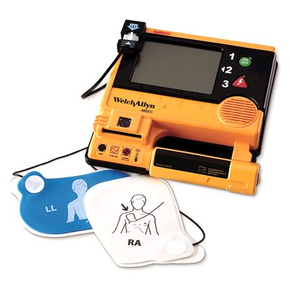
Finally…
I have helped support the AED training equipment procurement in preparation for the placement of these devices around the college.
A four (4) hour training was available to all who wish to be certified…about twenty staff members.

