Slide 1
Information Assurance/Cyber Defense
Baccalaureate Degree Proposal Application
Northern Michigan University

Slide 2
Information Assurance/Cyber Defense
The U.S. Bureau of Labor Statistics (BLS) projects a national employment growth rate of 22% from 2010 to 2020 for the category of workers that includes information security analysts, which is significantly higher than the average rate of 14% for all occupations.
According to the BLS, the median annual wage for that category of workers was almost $78,000 in 2011, an increase of more than $2,000 over the previous year. The top 10% earned more than $124,800 in 2011, up nearly $5,000 over 2010.
The BLS also noted that a 2012 survey conducted by Robert Half Technology, a consultancy and staffing service, estimated the pay range for data security analysts was $89,000 to $121,500.

Slide 3
Information Assurance/Cyber Defense
Institution | Program Type | Housed
Eastern Michigan University | Graduate and Undergraduate | School of Technology
Ferris State University | Center of Excellence | College of Business (but not AACSB accredited)
University of Detroit/Mercy | Concentration in Information Assurance (within Computer Science degree) | College of Education and Liberal Arts
Walsh College | Undergraduate | Information Assurance Education Center
Davenport University | Undergraduate and Master’s degrees | Information Security and Assurance Center

Slide 4
Information Assurance/Cyber Defense
All of the existing programs meet the knowledge units for the National NSA/DHS Centers of Academic Excellence in Information Assurance/Cyber Defense. However, NMU’s proposed program would be the only program in Michigan that will meet the Information Assurance/Cyber Defense learning outcomes and also be AACSB-accredited. A search found no such programs at the Baccalaureate level in Wisconsin.

Slide 5
Information Assurance/Cyber Defense
There is demonstrated need for this type of program. The program satisfies the knowledge units required for the National NSA/DHS Centers of Academic Excellence in Information Assurance/Cyber Defense at the baccalaureate level. Such a program should generate student interest and give a boost to NMU’s Information Systems offerings. In addition to meeting the NSA/DHS requirements, it is unique in that this program also satisfies requirements for AACSB accreditation.

Slide 6
Information Assurance/Cyber Defense
The curriculum conveys the body of professional knowledge in best practice with regard to Information Systems work. Its content is derived from and fully conformant with recommendations for programs of this type established by the Association for Computer Machinery (ACM) and the Institute for Electrical and Electronics Engineers (IEEE). In addition, the emphasis on Information Assurance allows the student to gain entry into the rapidly growing professional field of Information Systems Audit and Security.

Slide 7
Information Assurance/Cyber Defense
The concentration complies with the recommendations of the CNSS 4011 national standard for Information Security Professional Education and it meets the knowledge units required for the National NSA/DHS Centers of Academic Excellence in Information Assurance/Cyber Defense:

Slide 8
Information Assurance/Cyber Defense
This program has been designed to fall under the AACSB accreditation standards for the College of Business. Further, it has been designed to include the knowledge units required for the National NSA/DHS Centers of Academic Excellence in Information Assurance/Cyber Defense:

Slide 9
Information Assurance/Cyber Defense
Admissions Requirements
Are initially the same as admission to any Baccalaureate degree program at Northern Michigan University, namely 19 ACT score and 2.25 recomputed high school GPA. Students will also need to meet the College of Business admission requirements before taking 300- and 400-level business courses.
College of Business admissions requirements include:
The student must complete forty-eight (48) semester credits with a minimum grade point average of 2.25 in the pre-admission courses listed below.
The student must successfully complete the following pre-admission courses: EN 111 and 211; MA 103 and 171; ACT 230 and 240; EC 201 and 202; CIS 112 and 212; eight (8) semester credits in liberal studies courses; and other credits to total 48 semester credit hours.
Graduation Requirements – Students would complete 124 credit hours as described above and meet all NMU baccalaureate degree graduation requirements. Further, students would need to maintain a minimum 2.0 GPA in their business courses (business core and major combined). No grade below C- in CIS or IS courses will be allowed for graduation.

Slide 10
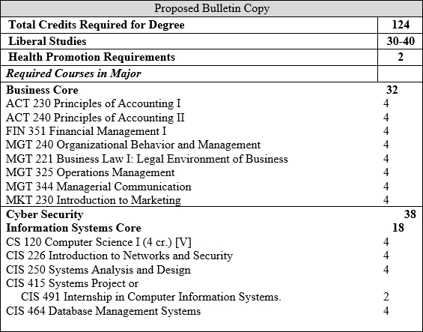
Information Assurance/Cyber Defense

Slide 11
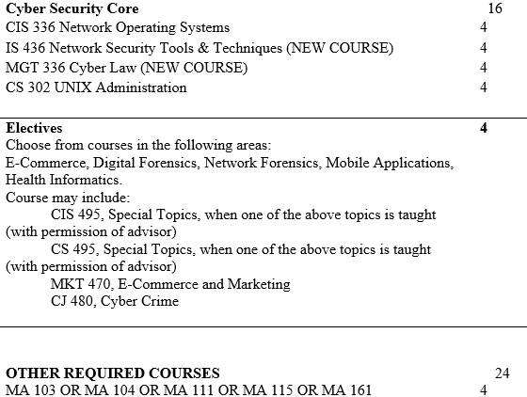
Information Assurance/Cyber Defense

Slide 12
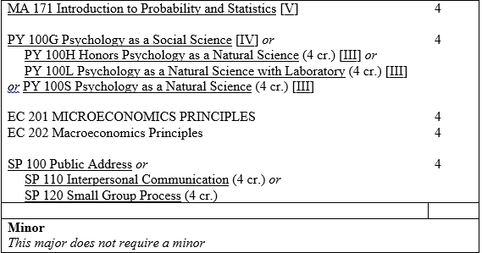
Information Assurance/Cyber Defense

Slide 13
Information Assurance/Cyber Defense
New Course
IS 436 Network Security Tool and Techniques 4 cr.
New Course
Prerequisite: CIS 336
Provides students with an in-depth view of advanced network technology and protocols, intrusion detection and prevention, network security administration, and data administration. Students will gain valuable hands-on experience using current tools and techniques for securing networks.

Slide 14
Information Assurance/Cyber Defense
New course
MGT 336 Cyber Law 4 cr.
New Course
Prerequisite: Junior Standing or departmental permission.
In-depth examination of laws dealing with computers and the Internet, including: US and international jurisdiction, computer security, intellectual property, electronic commerce, e-discovery, information privacy, freedom of expression, and cyber-crime. Detailed analyses of significant legal case studies plus review of applicable federal and state statutes such as HIPPA, Sarbanes Oxley, CFAA and the Patriot Act.

Slide 15
Information Assurance/Cyber Defense
Projected Enrollment:
We expect the following number of students interested in the program to be initially:
First year 20 students
Second year 30 students
Third and following years: 10% growth per year.
We have already heard from students in the computer majors at NMU that they are waiting for the program to come on board. CIS students are interested in changing to this major and CS students have requested a minor program in Information Assurance.

Slide 16
Information Assurance/Cyber Defense
Anticipated Costs- Faculty- One tenure-track position to direct and deliver the program, $97,000 plus benefits. Another tenure-track faculty member within three years to help build the program.
Equipment and Supplies- A networking computer laboratory; approximately $40,000 in computers and software.
Library-No additional costs.
Space- equivalent to one classroom. Initially a locked closet in a classroom would suffice.

Slide 17
Information Assurance/Cyber Defense
Staffing Plan- The new tenure-track faculty position will develop and implement the program. An existing term faculty member position will eventually be converted to a tenure-track position as enrollment grows to support the new and existing is programs. Depending on enrollments, another position could be requested at the end of three years. The liberal studies, business core and elective courses will consist of courses already being offered at the university. All but two of the business core and major courses (8 credits) are already staffed by faculty in the College of Business or in Computer Science.

Slide 18
Information Assurance/Cyber Defense
Required Equipment- No additional specialized equipment is needed.
Anticipated Library Usage-The current Olson Library holdings and on-line resources are more than adequate for this program.
Space Requirements- The current space available is sufficient for offering this program. In time, a classroom should be devoted as a dedicated networking/security laboratory.
Program Delivery- The program will be offered fall, winter, and summer semesters.
Program Delivery Format- The courses will be taught mainly as on-campus face-to-face courses. There will be an occasional course delivered on-line, but the majority will be on-campus.

Slide 19
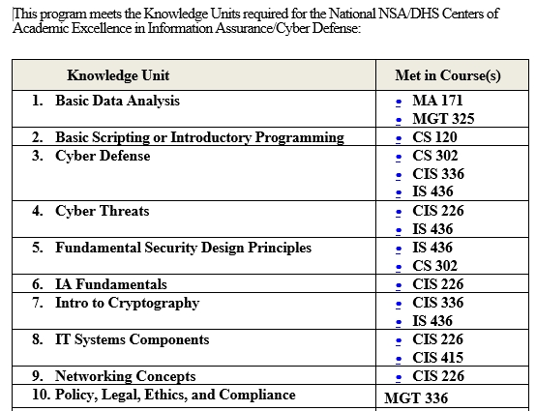
Information Assurance/Cyber Defense

Slide 20
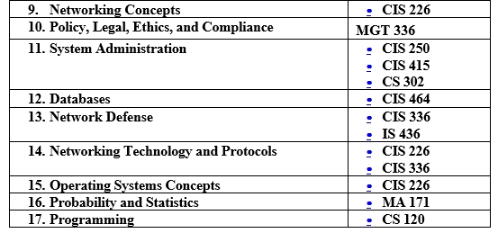
Information Assurance/Cyber Defense

Slide 21
Information Assurance/Cyber Defense
Planned Implementation Date- The program will officially start fall 2014.

