Slide 1
Future faculty fellowship application walk-through
Questions? Contact Graduate Studies and Research
graduate@nmu.edu; 906.227.2300

Slide 2
1:
Apply for the Future Faculty Fellowship (FFF) Program through the Michigan MiLogin System
This is the same system that you would use to access online Secretary of State Services; you may already have an account
Log in at https://milogin.michigan.gov/eai/login/
If you do not have an existing account, go to https://milogin.michigan.gov/uisecure/selfservice/anonymous/register to create an account. You will need to verify your email address and mobile number to finish the account set up, so be sure to be in a place where you are able to access these.

Slide 3
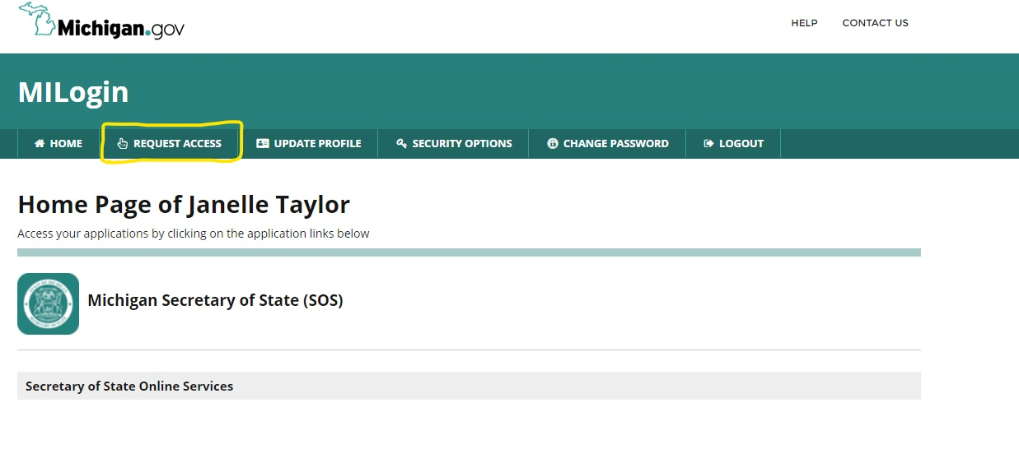
2:
Request access to the Future Faculty Fellowship application
Once you have created an account, you will have a home page that automatically gives you access to Michigan SOS Services. In order to gain access to the FFF application, you must request access.

Slide 4
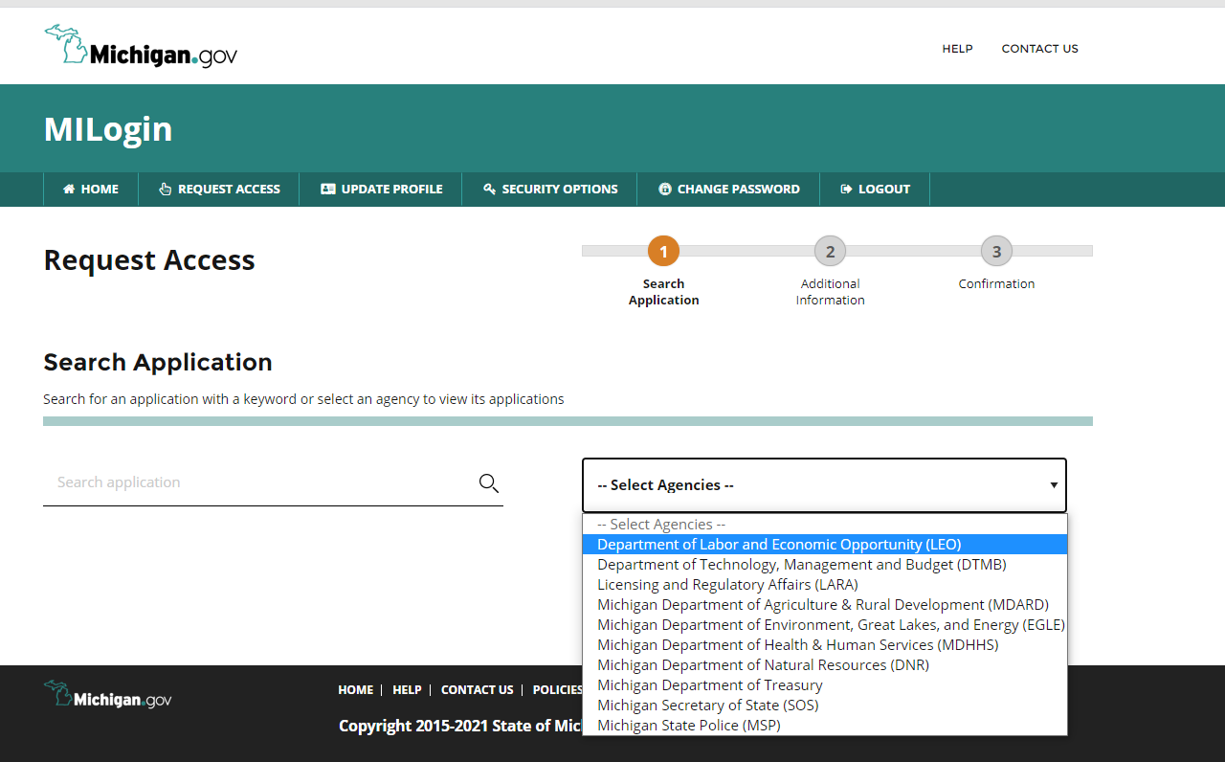
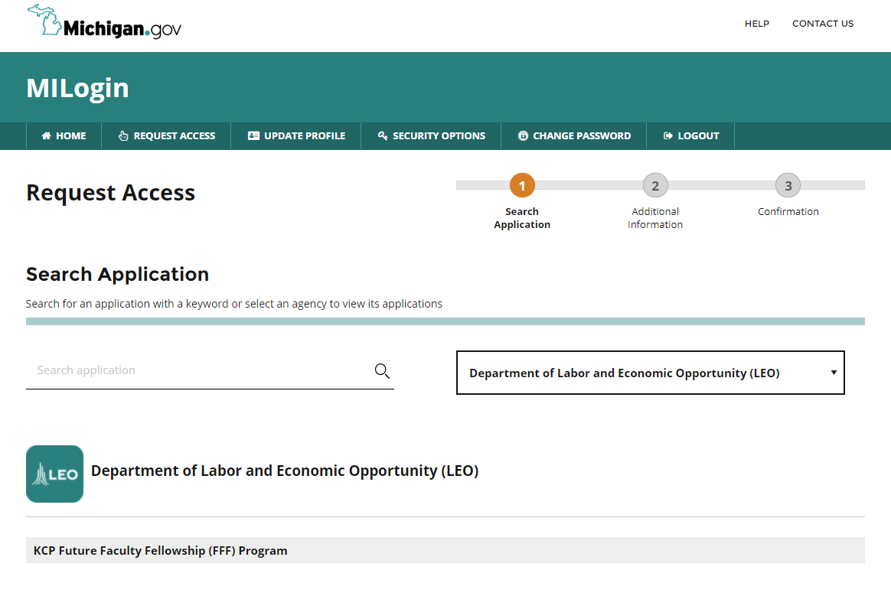
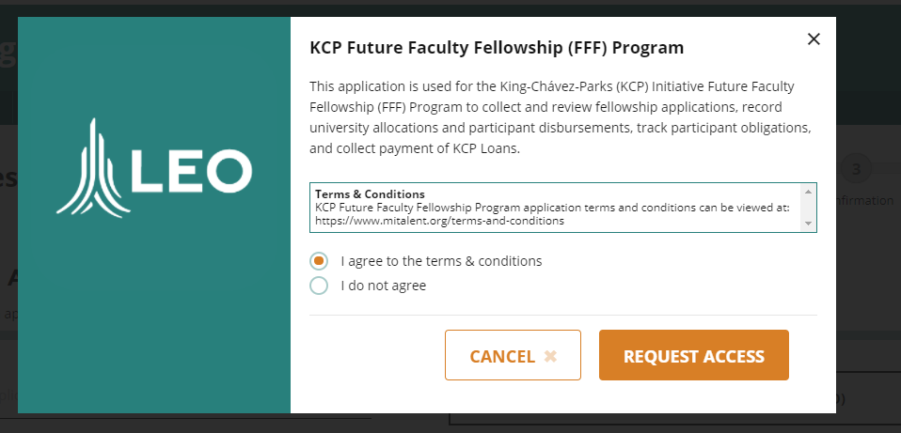
3:
The Request Access screen has a dropdown menu of departments within in the state that you can request access to.
FFF is part of LEO, the Department of Labor and Economic Opportunity.
Follow the prompts to request access to the KCP Future Faculty Fellowship Program.

Slide 5
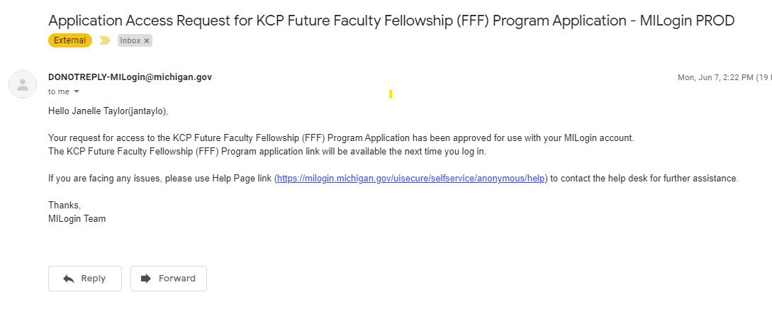
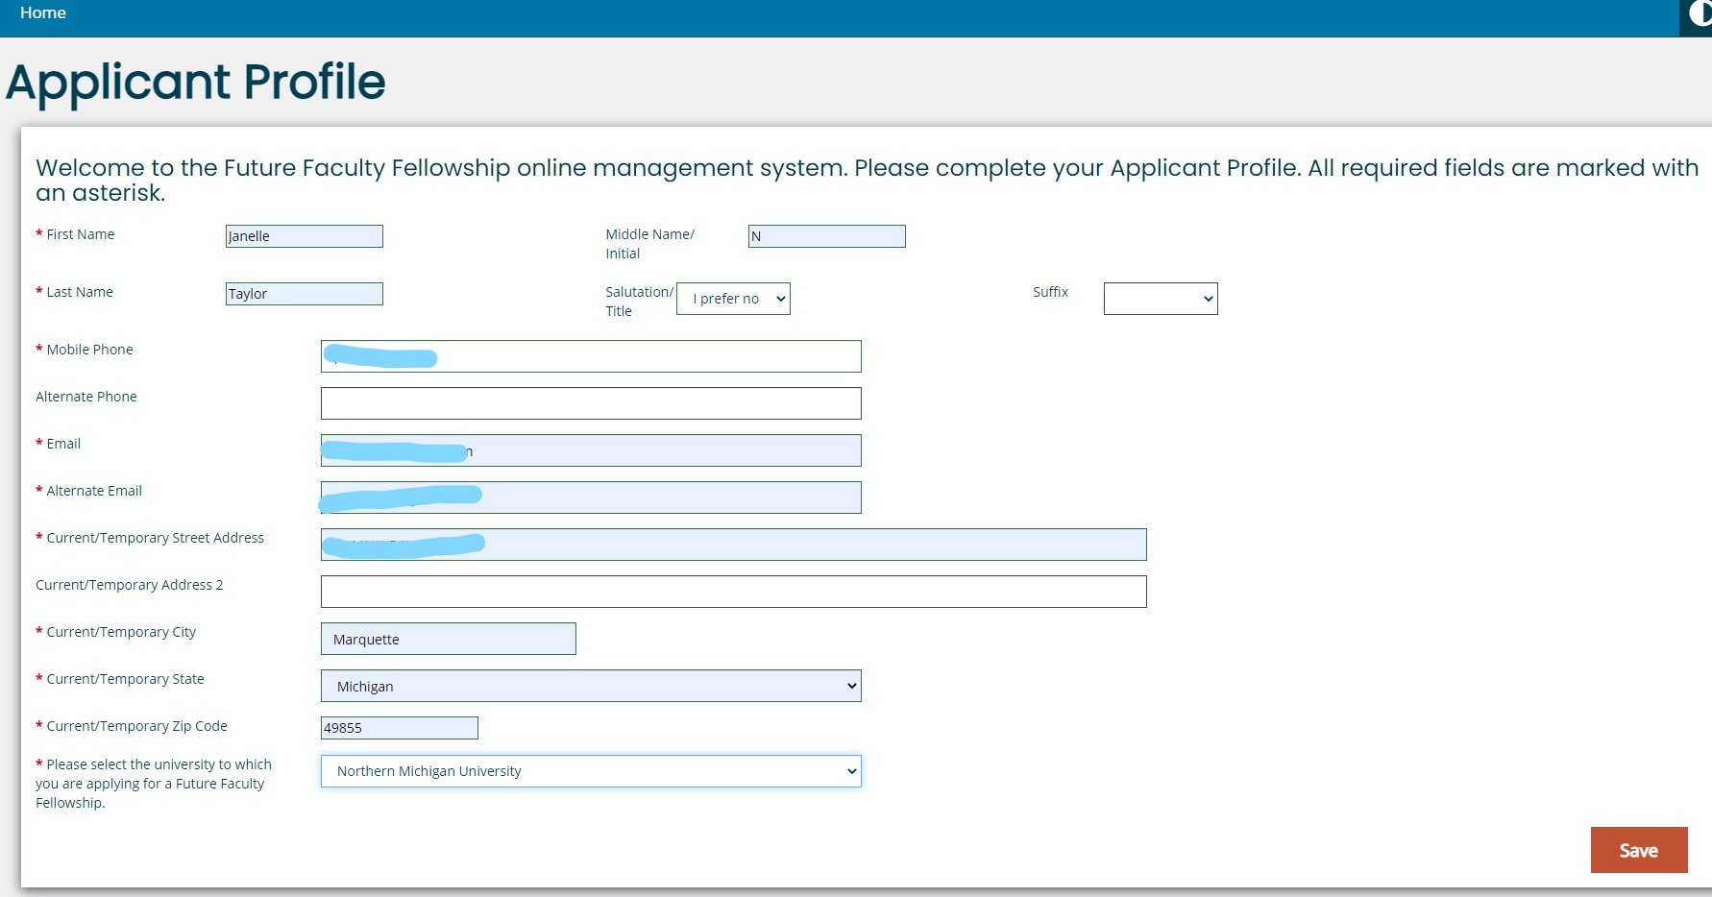
4:
Once you request access, you will receive an email from MILogin@Michigan.gov granting your access. (This seems to take only a couple of minutes).
To see your new access, you will need to log out and then back in to the application portal. When you sign back in, you will need to complete your applicant profile.

Slide 6
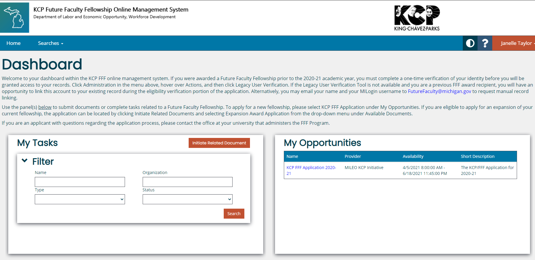
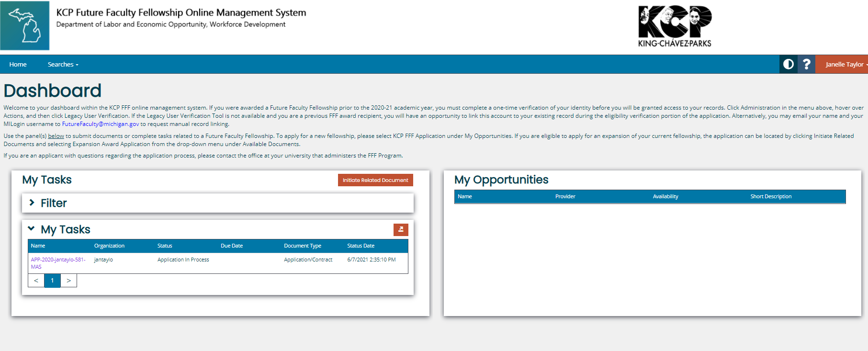
5:
Once your profile is complete, you will have a dashboard within the KCP FFF Online Management System.
To begin your FFF application, click on the link to the KCP FFF Application in the My Opportunities section.
The application allows you to save and log back in if you are unable to finish it at one time. Once you begin an application, the application link moves to the My Tasks section of your dashboard.

Slide 7
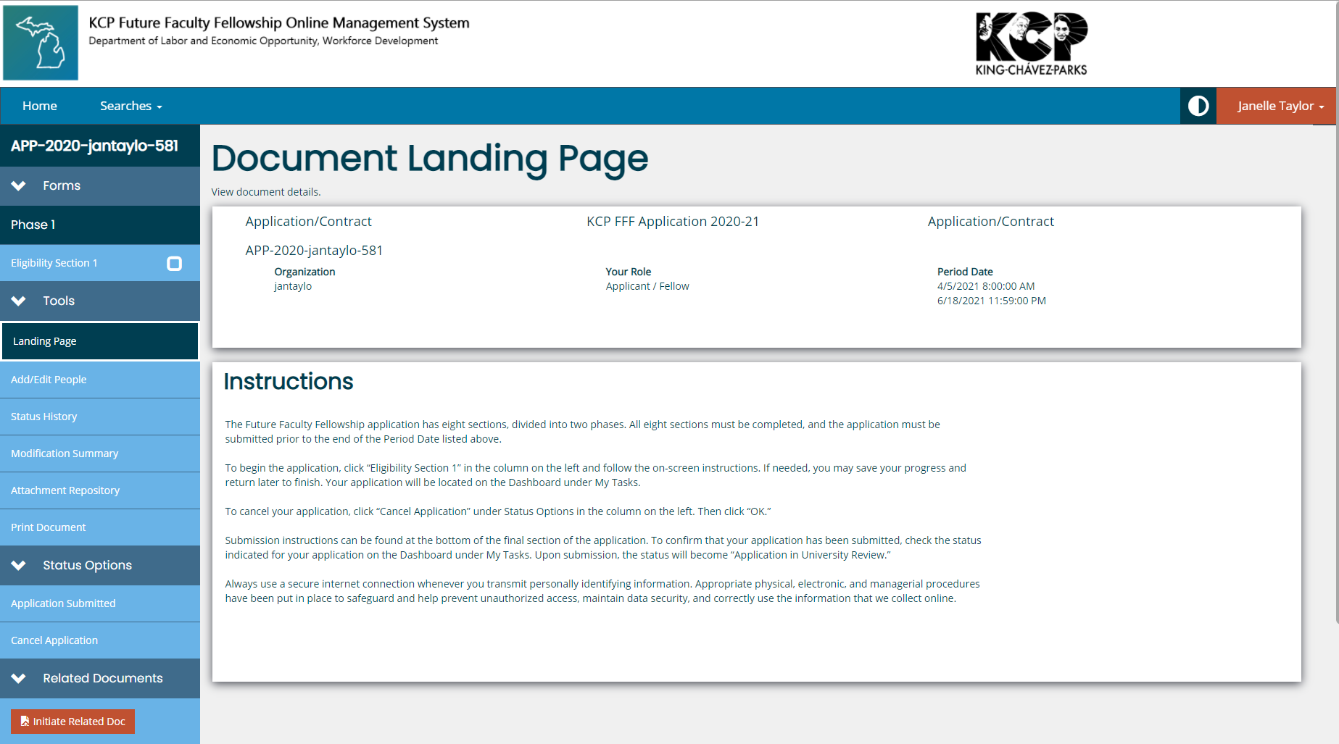
6: Once you are in the application, you are taken to the Document Landing Page. After you have read the instructions there, click on Eligibility Section 1 to start filling out the application.

Slide 8
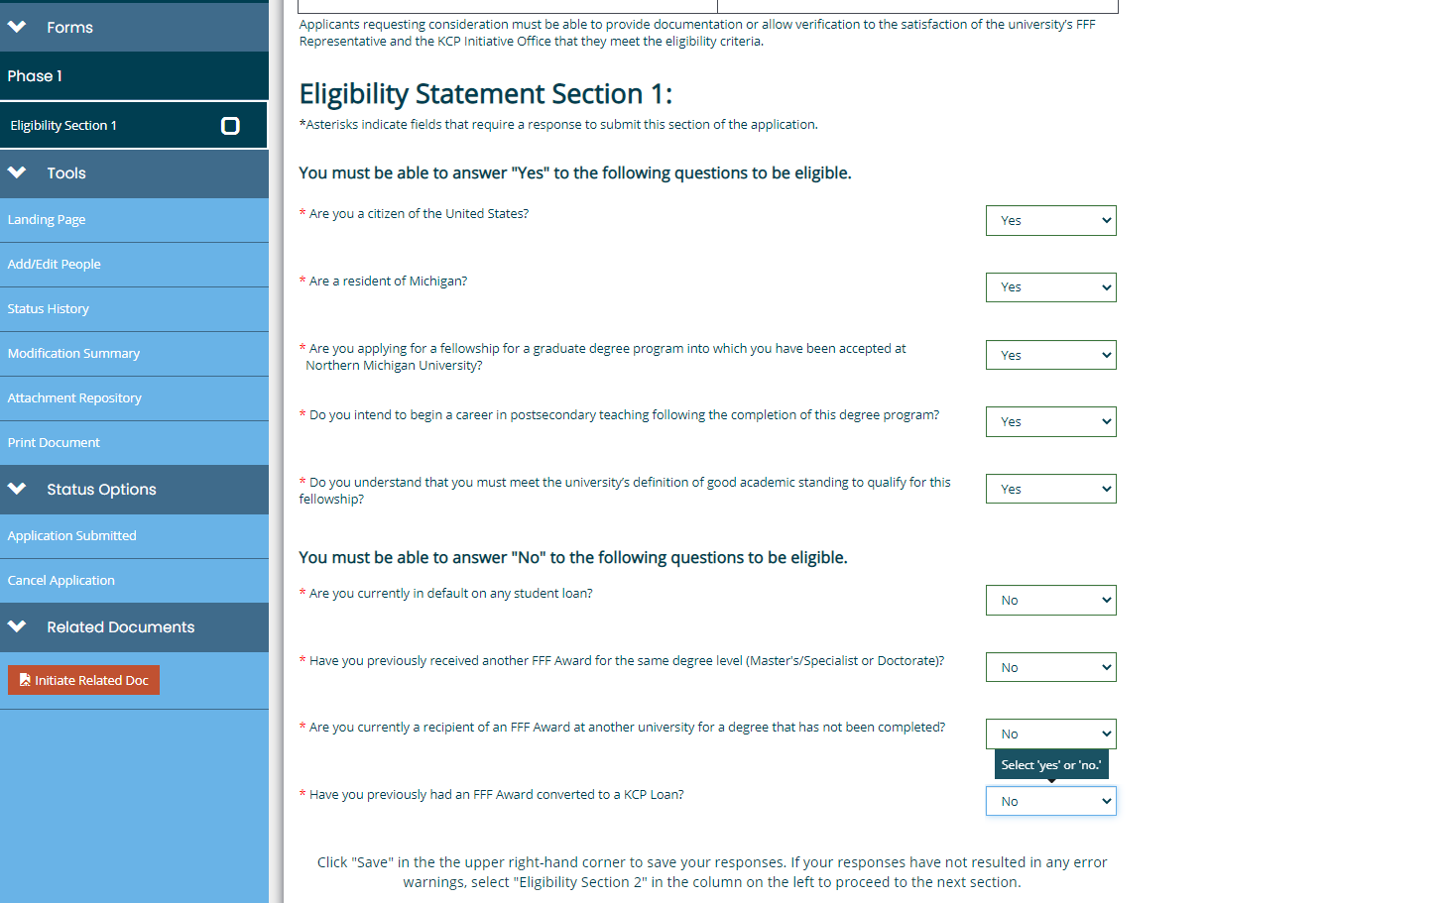
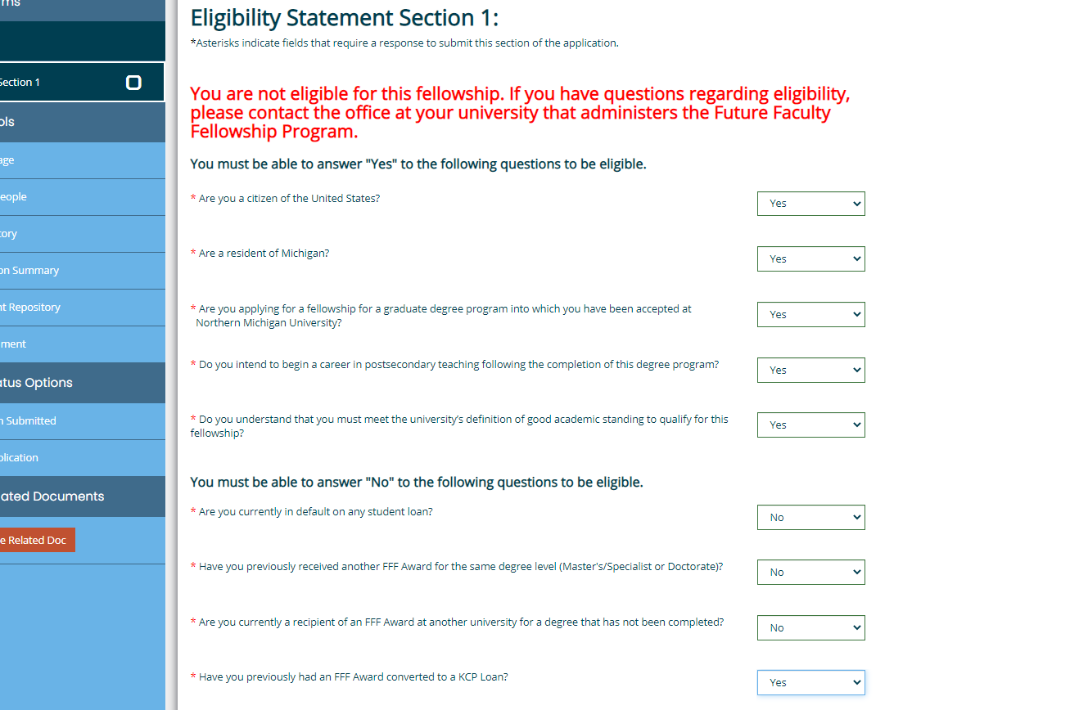
7:
Eligibility. In section 1 you are confirming that you meet the eligibility requirements. You should have already reviewed these prior to starting the application. The system will stop you if you have a factor that makes you ineligible.
Remember that the application is a legal document so it is important to be truthful.

Slide 9
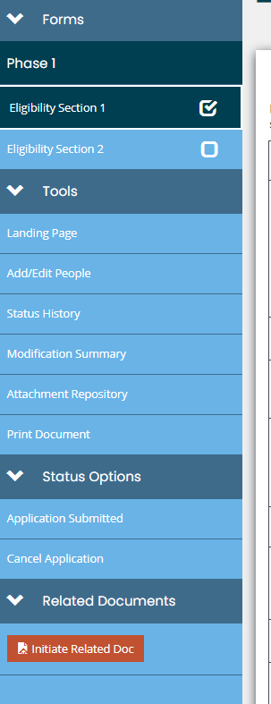
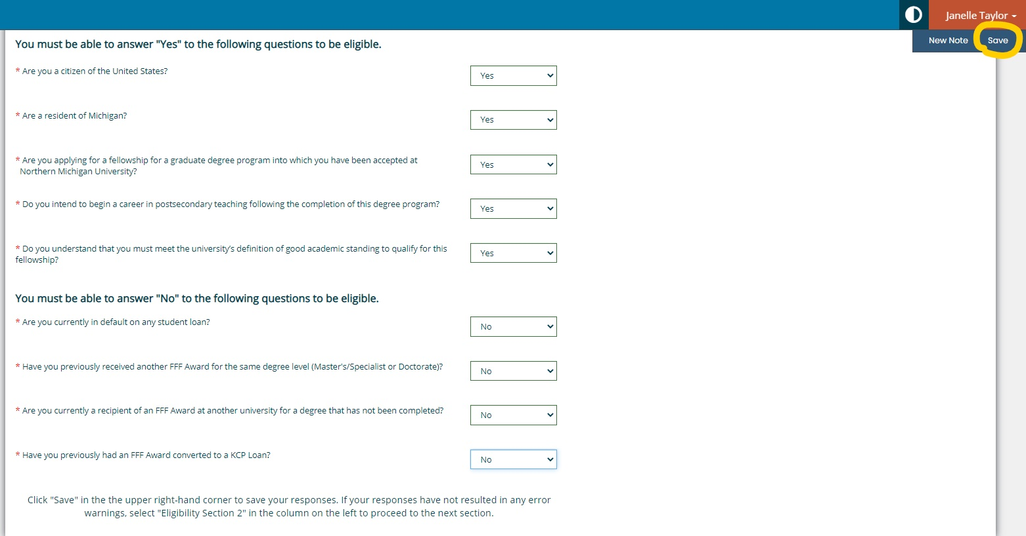
8:
Saving and progressing:
When you have completed a form in the application, use the Save button in the upper right corner to save your progress.
Once you have completed a section, you will see a checkmark in the page’s box in the left navigation. If something is incorrect, you will instead see a warning exclamation there.
To move on after you have completed and saved a page, you must click on the next page that appears in the left navigation pane. In this example, I have completed Eligibility Section 1 and now will click on Eligibility Section 2 to begin filling out page 2.

Slide 10
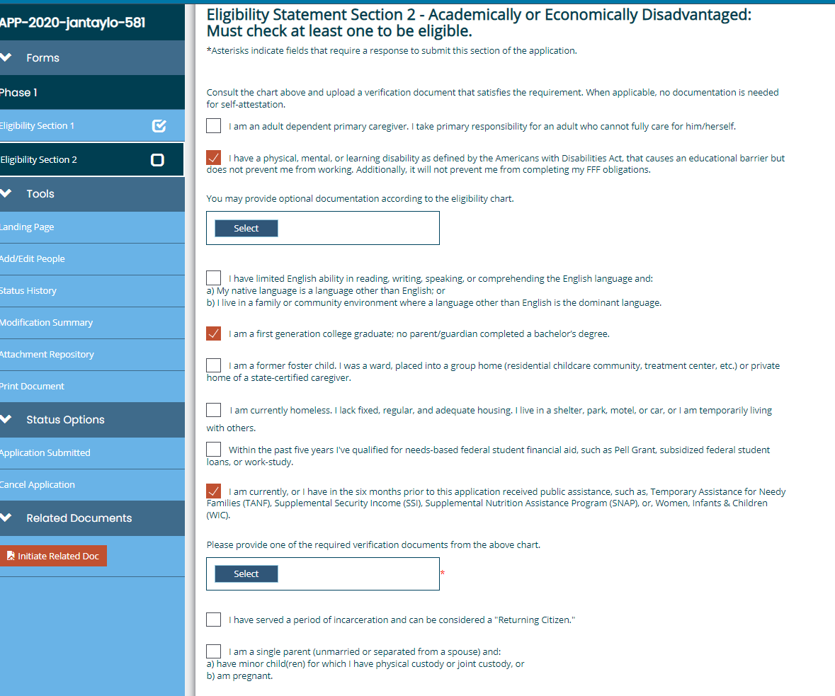
9: Eligibility Section 2: In this section you must select the way(s) in which you qualify as an economically or academically disadvantaged person.
Note that you will self-select the categories, but different categories require different types of documentation.
In the boxes checked in the example, one requires documentation, one has an optional documentation, and one is self-attestation (checking the box).

Slide 11
10:
The information from Eligibility Section 3 will be used to verify the information you provided in the other screens. The bottom agreement and certification check box outlines the ways in which your information will be used.

Slide 12
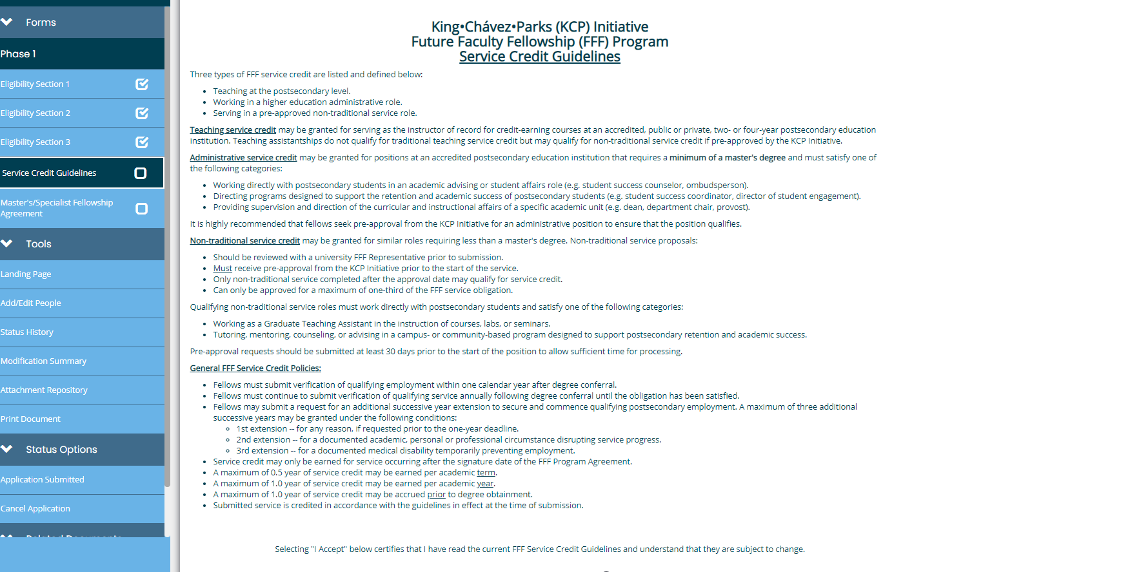
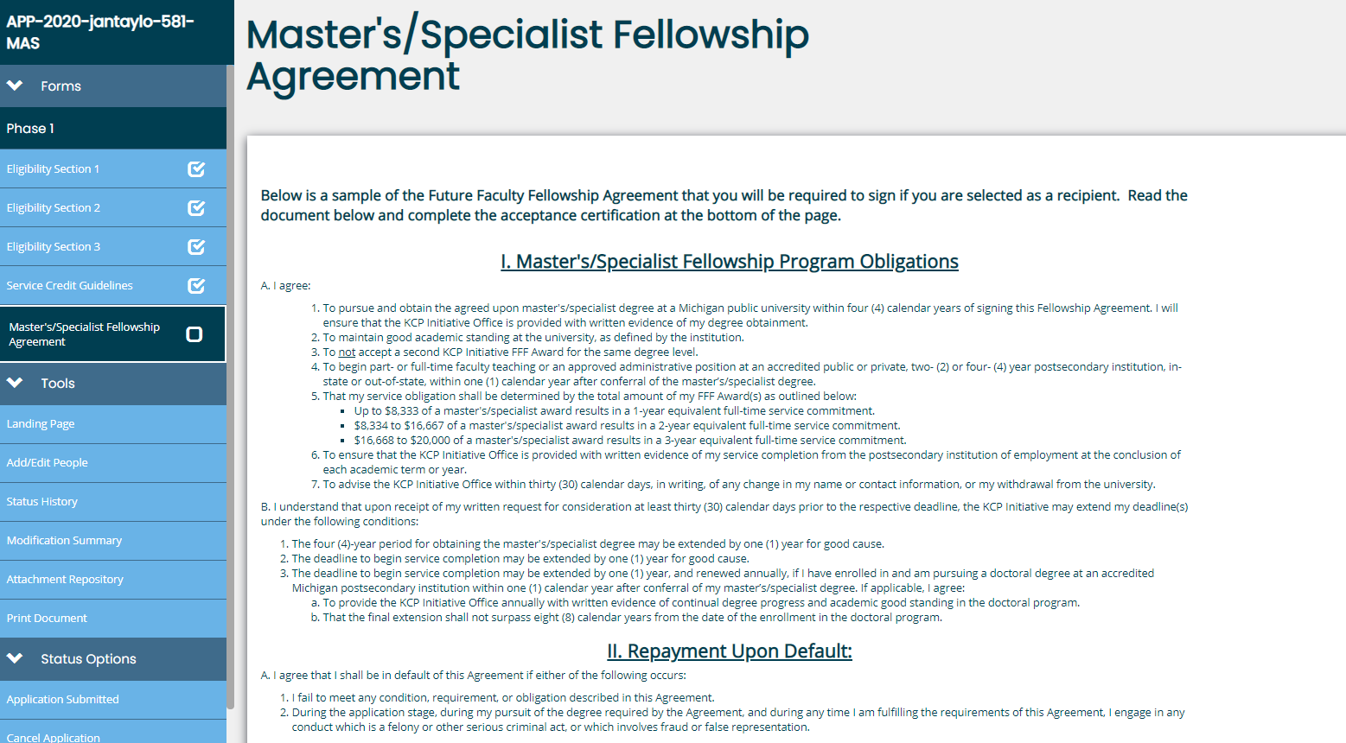
11: Guideline Sections: These screens describe the service requirements and guidelines for use of the award, should you be awarded. Become familiar with these. There are copies of these documents available at NMU’s FFF website: https://nmu.edu/graduatestudies/future-faculty-fellowship

Slide 13
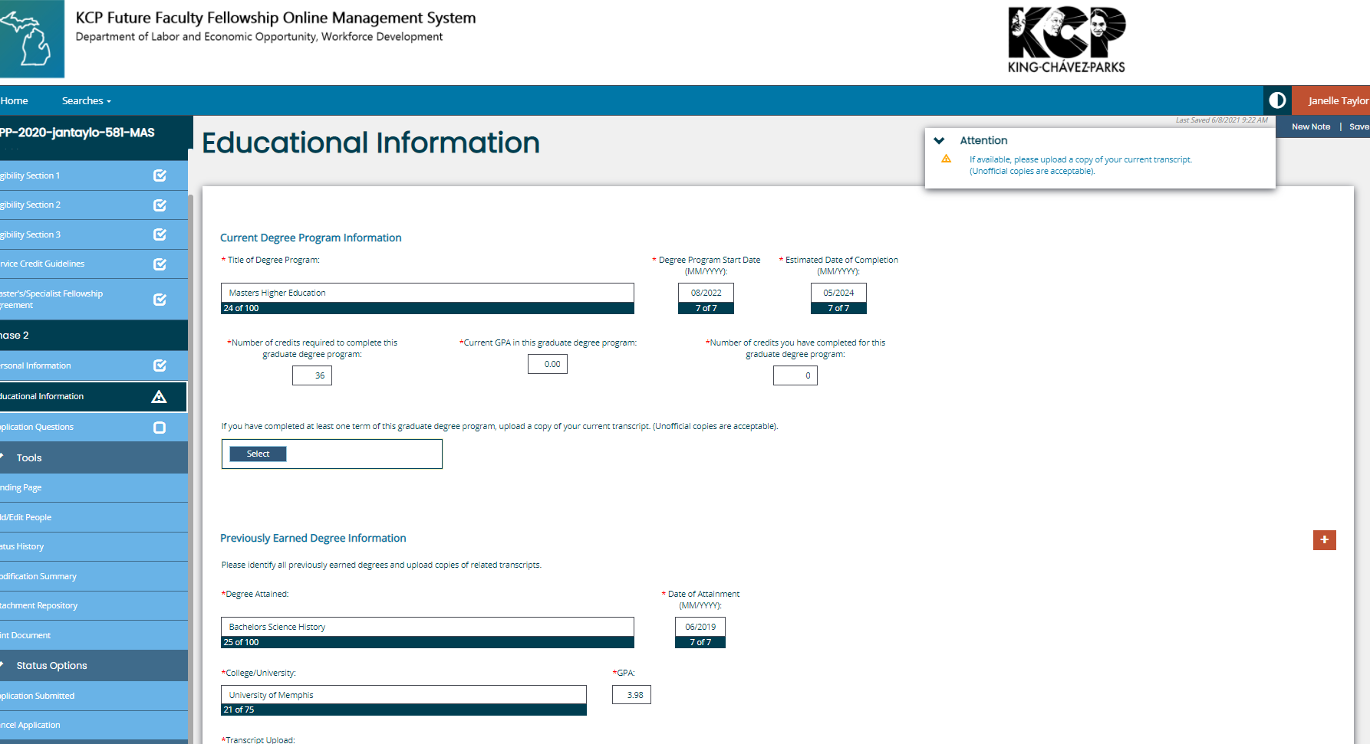
12: Personal and Educational Questions: For the personal section, you will need your driver’s license number and school ID number. In the educational section, you will input your higher educational history. You will need unofficial transcripts. These can be screenshots or PDFs of your academic records that you have in your student portal.
Note: even though I entered this section as if I was starting my degree in the future and the masters degree transcript section says it is optional, the system continued to show an warning error note when I saved which will have to be eliminated in order to submit.
We recommend uploading your admission letter or application if you do not have masters level transcripts yet.

Slide 14
13: The final page asks you to upload your goal statement, CV, budget, and letters of recommendation. Be sure to pay attention to the topic note and required guidelines for these documents.
For templates and assistance with these documents refer to https://nmu.edu/graduatestudies/future-faculty-fellowship or contact Graduate Studies and Research.

Slide 15
Submit! The bottom of the application documents section instructs you in submitting your application. The application cannot be changed once you submit it.
Note: Saving your application does not submit it. To submit, you must click Application Submitted in the left navigation area.
After submission, NMU’s FFF Award Committee will review applications. If the committee has questions about an application, they may reach out to you for additional information. Check your email and respond to these requests as quickly as possible. The awarding process moves quickly!

