Slide 1
Thesis Formatting and Planning Janelle Taylor, Coordinator of Graduate Student and Research Affairs College of Graduate Studies and Research

Slide 2
Hello
Who are you?
Name, program, stage of thesis
What do you hope to learn today?
Janelle Taylor
My program was Higher Education and Student Affairs
I am 4 years post thesis (yay!)
I hope to learn a few new things that can help this presentation be great.

Slide 3
What is a Thesis?
Your thesis will be the final product of your time in graduate school.
A thesis is a substantial piece of scholarly writing that reflects the writer's ability to:
conduct research
communicate the research
critically analyze the literature
present a detailed methodology and accurate results
verify knowledge claims and sources meticulously
link the topic of the thesis with the broader field
Notes:
You should be planning your thesis early in your degree program

Slide 4
Your Committee
A thesis committee is made of: a faculty chair/advisor, and two or three committee members.
The members may be from outside the university, but they will have to meet graduate faculty status requirements.
Your thesis advisor can be, but does not have to be your faculty advisor assigned to your at admission.
When choosing faculty to ask to be your thesis chair, look for people who: are involved in the type of research you want to do, are knowledgeable about the thesis process, and are sufficiently easy to contact (hint: if it is hard to find a time to ASK someone to advise/chair your thesis, they probably will be hard to communicate with during your thesis)
All members of your committee must have graduate faculty status.
You can view the list of Graduate Faculty here: https://www.nmu.edu/graduatestudies/graduate-faculty-status-and-terms
Thesis Proposals: Some departments have students create a proposal outlining their intended research and present it to their faculty. This is a great way to get feedback on your research ideas. Check with your advisor to see if this is a practice in your area.
Notes:
Distribute Thesis Advisor Checklist

Slide 5
Thesis Proposal Approval Form
This form should be filled out by you and your thesis advisor/chair and turned in before you take any thesis credits.
If something changes during your thesis process you must fill out an updated form and submit it to the Grad College.

Slide 6
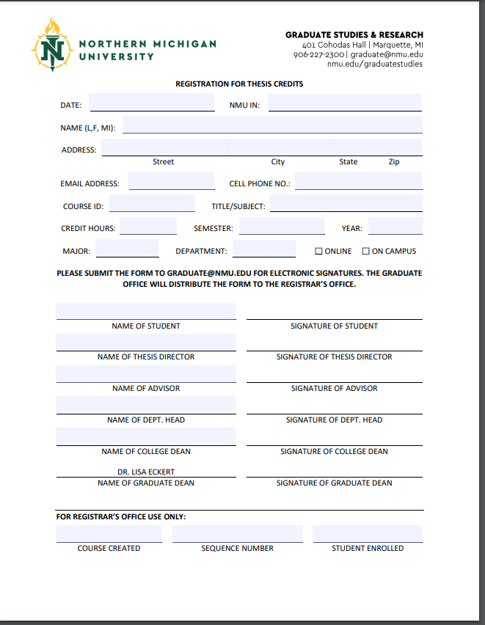
How Do I Sign Up for Thesis Credits?
Signing up for thesis credits is similar to signing up for a directed study.
Meet with your advisor and plan you thesis credit plan before registering for any credits. Thesis credits will stay on your transcript even if you don’t complete a thesis.

Slide 7
Thesis Credits
Thesis credits can be split between semesters, just know that you will get an ‘R’ grade in those credits until you complete your thesis
Plan your thesis before registering for thesis credits. If you change your mind and do not finish your thesis, ‘R’ grades will become Unsatisfactory or F grades after 3 years
Also note: All Graduate classes are good for 7 years. If you do not complete your degree within 7 years of your first graduate class, you may be required to retake classes before you are able to get your degree.

Slide 8
Responsible Conduct of Research: Compliance
Responsible conduct of research is central to the reliability and usefulness of research.
If you are working collaboratively, talk to your thesis advisor about acquisition, management, sharing and ownership of data
Be familiar with peer review, publication practices, and responsible authorship
Compliance documentation MUST be included in your thesis if your research involves animals or humans IN ANY WAY.
IACUC: animal welfare
IRB: human subjects
The Research Compliance Training Powerpoint is available on the Grad Studies Workshops page: https://www.nmu.edu/graduatestudies/workshops

Slide 9
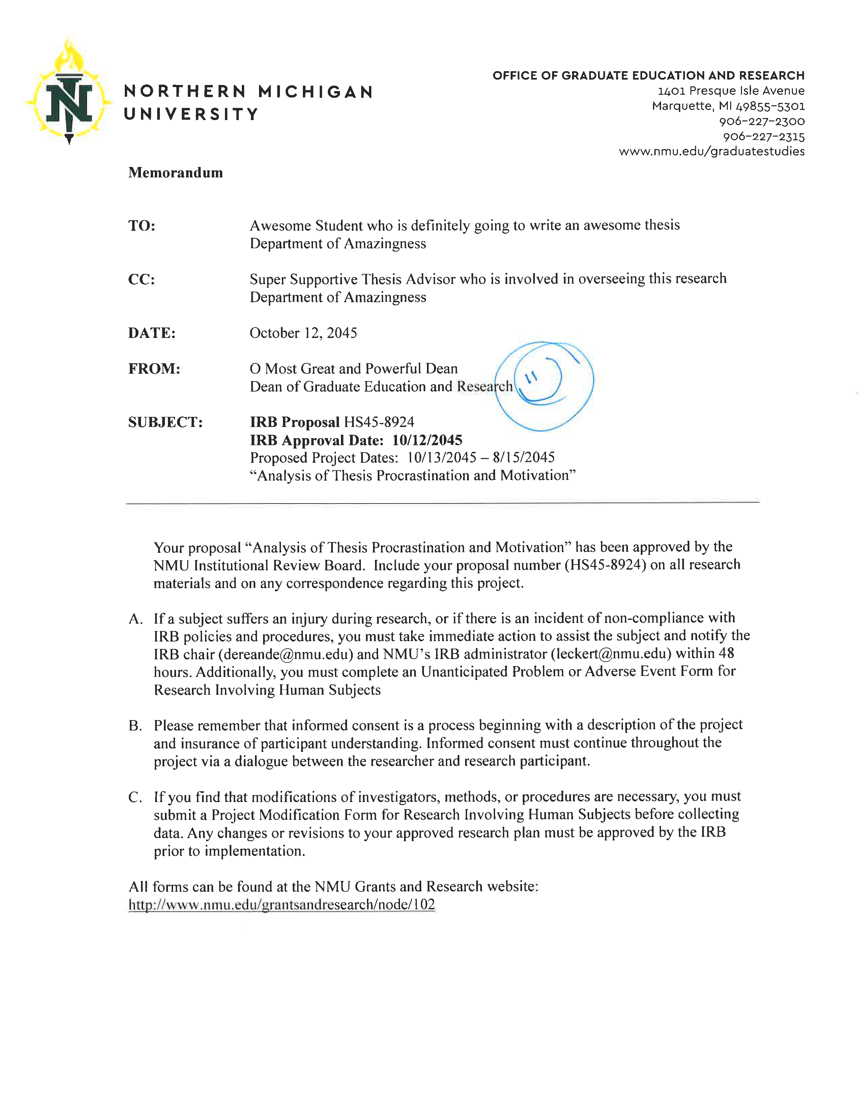
Research Committee Approval
Compliance documentation MUST be included in your thesis if your research involves animals or humans IN ANY WAY.
IACUC Committee oversees animal use in research
Email: iacuc@nmu.edu
IRB Committee oversees human subjects in research
Email: hsrr@nmu.edu
If you are unsure whether your research requires clearance by these committees, contact them BEFORE beginning your research and ask.
If you are told that your research does not need IRB/IACUC approval, keep that email and include it as an appendix in your thesis.
The approval letter in your thesis MUST BE the signed version. For IRB that is the letter on letterhead with the Dean’s initials. For IACUC, that is the first page and signature page of your IACUC application.

Slide 10
Copyright and Fair Use IN Your Thesis
Students are required by NMU and by ProQuest/UMI policy to ascertain that use of all copyright-protected materials either falls within the Fair-Use Statutes of U. S. Copyright Law or are reproduced with the permission of the owner. See K. D. Crews, Copyright Law and Graduate Research (https://media2.proquest.com/documents/copyright_dissthesis_ownership.pdf) for further guidance.
Your thesis must be written by you and unpublished--the University represents and warrants that it has the full right, power and authority to enter into an agreement with ProQuest and will not violate any third party rights. Essentially, you are publishing your thesis—though this does not limit your ability to publish your thesis outside of the university after you graduate.
Notes:
Distribute Fair Use packet. ProQuest: my elect not to distribute the Work if it believes that all necessary rights of third parties have not been secured.

Slide 11
Collaborative Work
The whole thesis must be written by you, in your own words, including the results and the proofs that were actually due to the collaborator. Moreover, you must perfectly understand, and be able to explain, and defend, all the results, as part of your project.
You must secure permission from the collaborative researcher(s) to include joint data/results
You must list collaborations and permissions in the “Acknowledgments” page in your thesis. You can also embed additional details in the appropriate section of your thesis.
Note: the optional “Dedication” section is for personal acknowledgements.
If you receive funding for any part of your research, the funder should be mentioned on the acknowledgements page. This includes any funding through NMU.

Slide 12
Literature Review Tips and Tricks
https://nmu.edu/graduatestudies/thesis

Slide 13
Thesis Defense
What is a thesis defense?
It is less scary than it sounds! A defense is you presenting your thesis to your committee, faculty, and other interested parties. The committee and/or audience at the defense will ask questions about your research, knowledge, and results.
Thesis defenses vary by department, so talk to your committee about what is expected.
Coordinate a defense of your thesis with your committee and department well in advance. Your thesis must be defended BEFORE the thesis turn-in deadline.

Slide 14
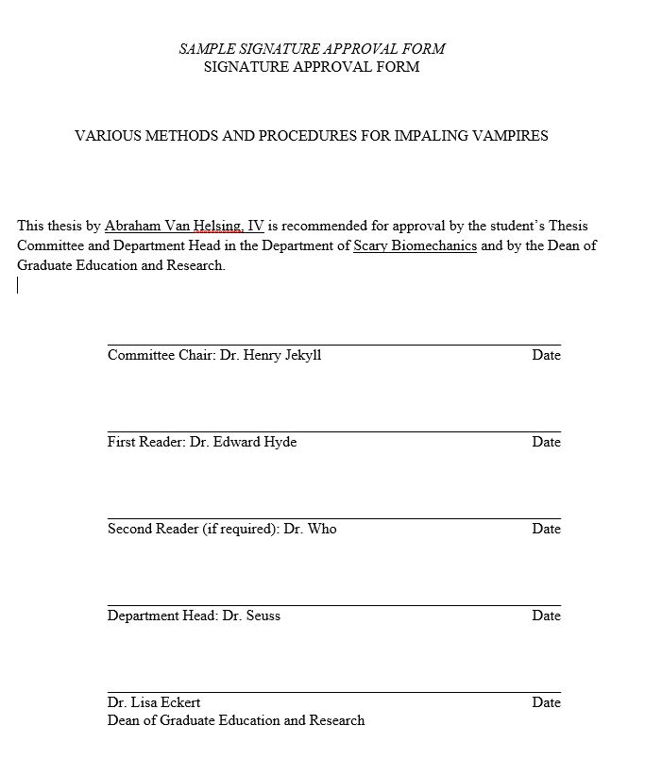
Final Signatures
After defending your thesis, your committee will ask for revisions. Once they are satisfied with your work, they will sign the Signature Approval Form.
SIGNED PAGE: The original page (paper or digital) must be turned in to the Graduate Office. Leave the Dean of Grad Studies line blank. That will be signed when the Dean has accepted your thesis.
IN YOUR THESIS: Include an unsigned copy that lists the names of your reviewers in your thesis document

Slide 15
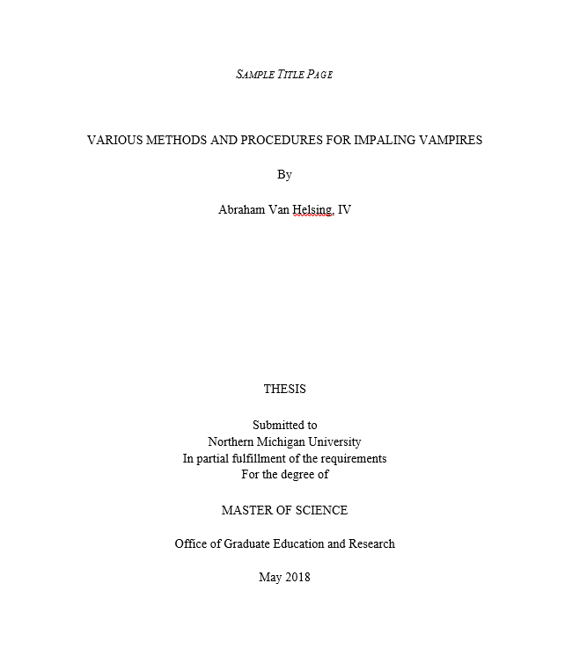
Thesis Format
Refer to NMU Guide to the Preparation of Theses https://www.nmu.edu/graduatestudies/thesis for information on preparing and formatting your thesis. If you follow these guidelines from the start, you will save yourself a lot of time later on the final version of your thesis.

Slide 16
The Thesis Approval Process
Defend thesis
Thesis Committee signs approval form
Make any revisions required by the committee discussed at the defense
Resubmit your thesis to the Chair and/or committee
Once your thesis Chair approves, upload your thesis to the Commons
Graduate Studies will send the Commons version to your Chair to confirm that it is the correct version that they approved
Once the Chair approves, Grad Studies will review the thesis for formatting and compliance regulations
If you need to make changes in these areas, you will get an email requesting minor revisions
Make the revisions and re-upload to the Commons
If the changes meet guidelines, the thesis is sent to the Dean of Graduate Studies and Research for approval. When she approved it, the thesis is posted and you get to breathe a huge sigh of relief.

Slide 17
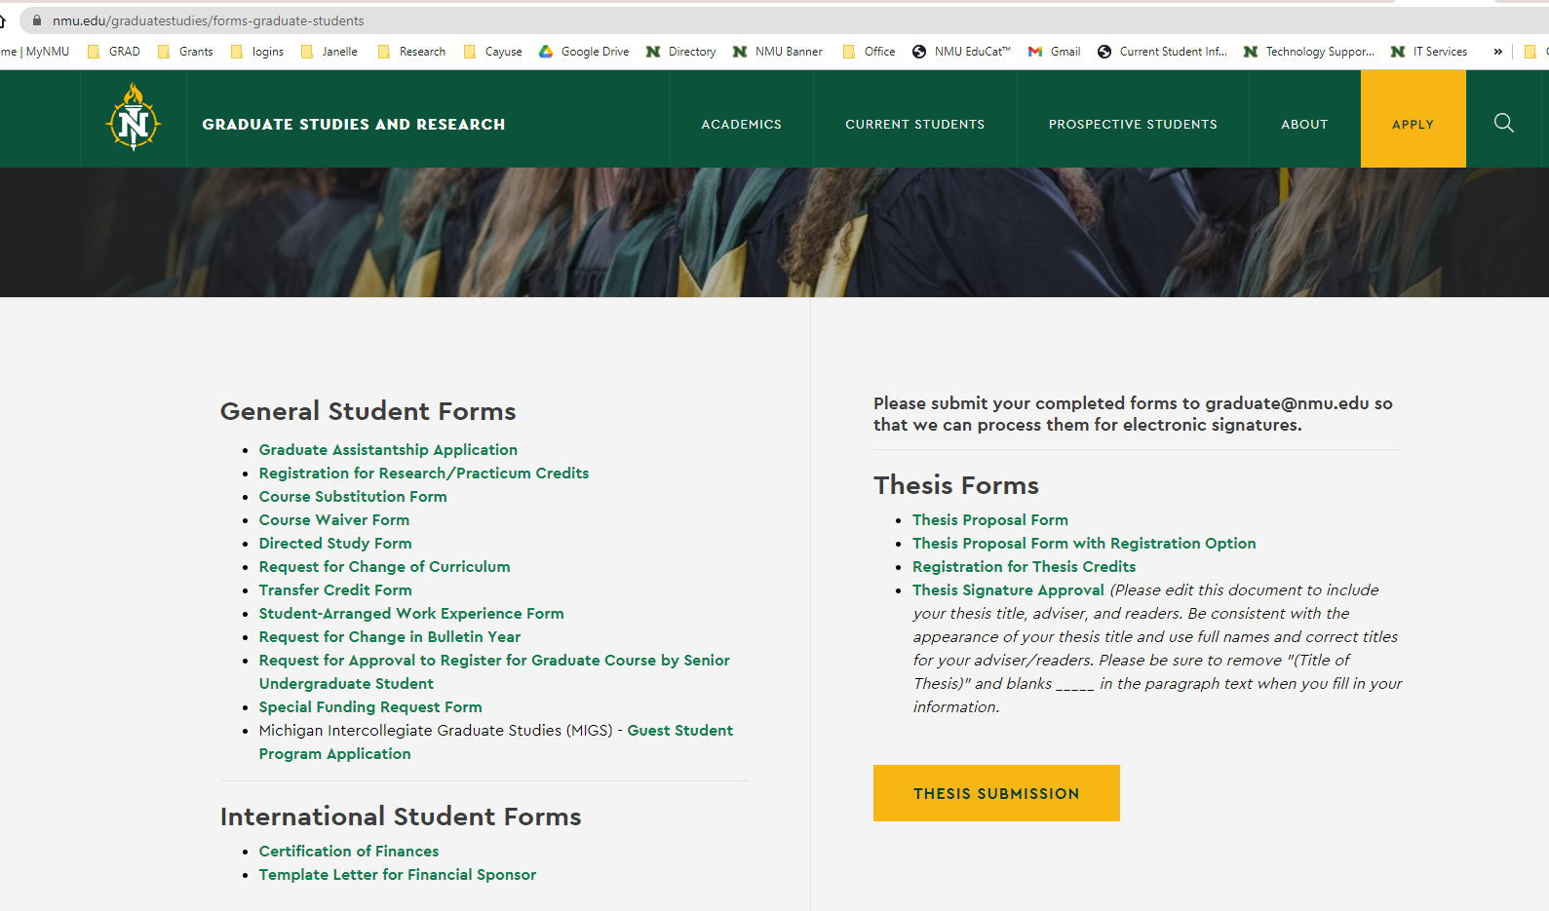
The Commons
You will upload your completed thesis to The Commons: https://commons.nmu.edu/theses/guidelines.html
Deliver the original signed Signature Form to the Graduate Office (401 Cohodas) OR arrange for digital signatures (ahead of time!) through the College of Grad Studies
Signature page thesis committee and department head original signatures – Graduate Dean signature line to be left blank
Before you upload be sure you have:
The thesis title
Names and e-mail addresses for your readers/advisors.
A list of keywords separated by commas (10 maximum)*
The abstract (up to 250 words)*

Slide 18
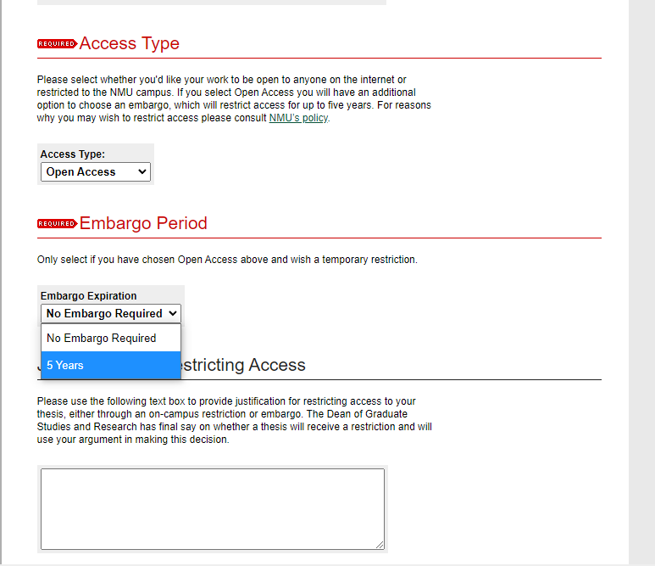
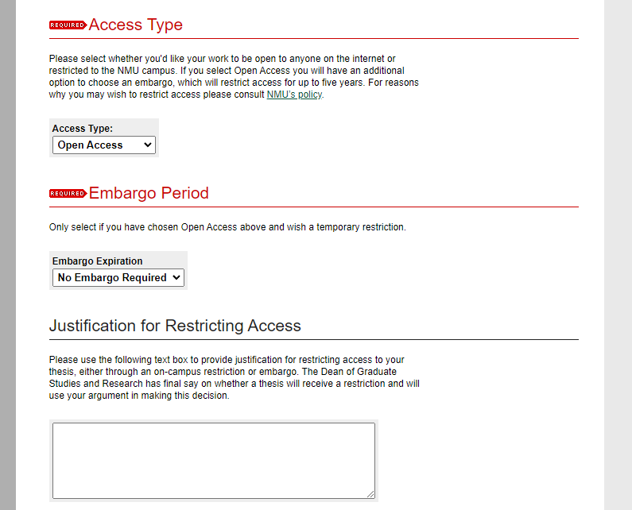
Thesis embargo option
If you need your thesis to not appear for public viewing on the Commons, you can request a thesis embargo.
Embargo options: Restrict to NMU only, or restrict entirely
Embargos expire after a period of time and must be renewed by the author.
Embargos are most useful for students who are looking to publish and make money from their thesis text.
Publishing your thesis on the Commons does not effect your ability to publish the same information with academic publishers. Most of the time, it is in your best interest to have your thesis published publicly

Slide 19
Common Thesis Troubles
Citation: You must list your preferred method of citation. The Guide says: The guide or format followed must be specified in the acknowledgments, the preface, or the introduction, in that preferred order.
Signature Page: the original signed signature page must be physically brought/mailed to the Graduate Studies Office. Your thesis submitted to the Commons should have an UNSIGNED version, but still list the title and names of your committee.
Human or animal subject approval memo: the approval memo or email/form stating that it is not needed for your human or animal research. This must be scanned and entered as an appendix in your thesis. This version must be the one that is signed by the Dean of Grad Studies and is on official letterhead.
If you don’t have one, your advisor should have received this by campus mail. If they can’t find theirs, contact the Grad Office.

Slide 20
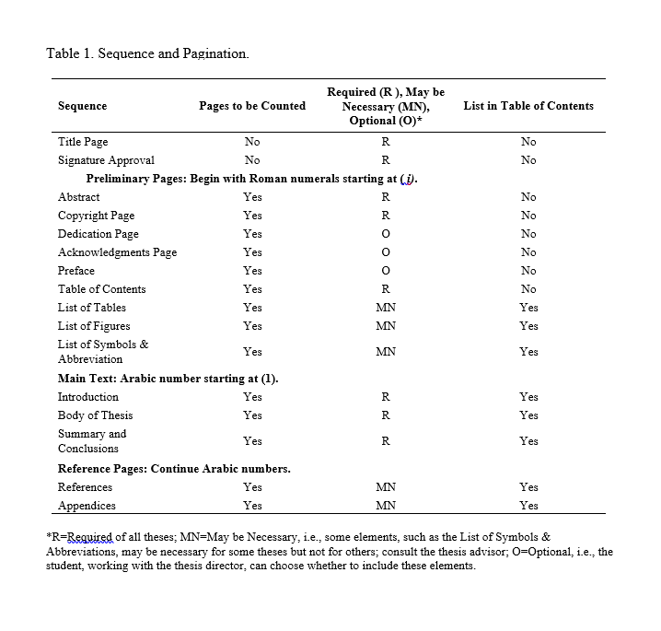
The Worst Part: Page Numbers
Page Numbers are centered and at the bottom of the page
< Note where to use Roman numerals (i, ii, iii…) or Arabic numbers (1, 2, 3,…)
So very helpful: https://nmu.edu/graduatestudies/thesis “How to Format Thesis Page Numbers”

Slide 21
Thesis Submission Due Dates
Spring 2022: April 1
Summer 2022: July 8
Fall 2022: November 18
General rule of thumb, theses are due 1 month before graduation
Updated dates are available here: https://www.nmu.edu/graduatestudies/thesis

Slide 22
Questions?
All thesis documents and forms in this presentation can be found at: https://nmu.edu/graduatestudies/thesis
If you need help, contact me at jantaylo@nmu.edu or graduate@nmu.edu or 906-227-2300

