Slide 1
External funding Part 2: Proposal Writing

Slide 2
Basic Parts of a Proposal

Slide 3
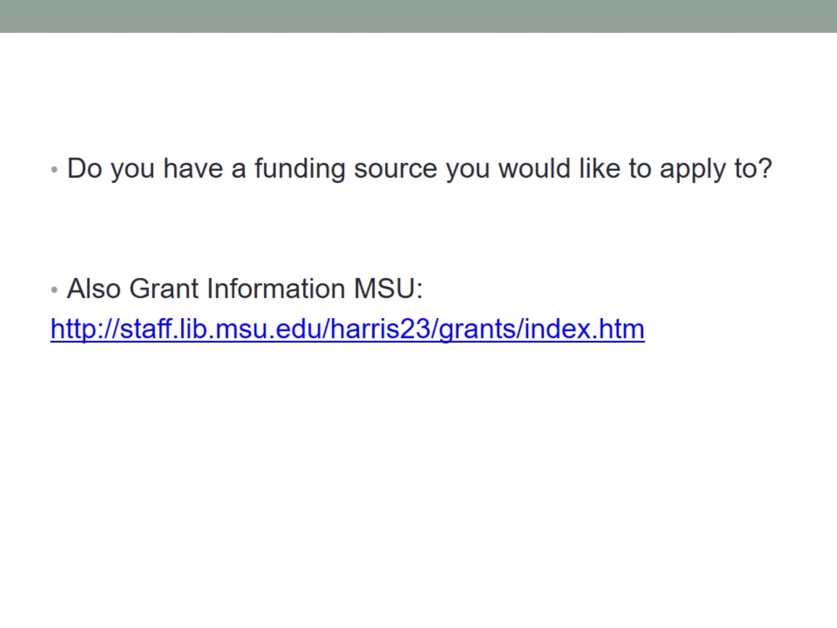

Slide 4
Quick…Help…

Slide 5
Not an Academic Journal Article

Slide 6
You must convince the reviewers…

Slide 7
Intrigue the Reviewers

Slide 8
The narrative

Slide 9
Introduction

Slide 10
Project Goals & Objectives

Slide 11
Review of Literature

Slide 12
Description of Proposed Project

Slide 13
Plan of Action, Methodology and Design

Slide 14
Personnel

Slide 15
Evaluation

Slide 16
Dissemination

Slide 17
Lit review

Slide 18
Purpose of the Lit Review

Slide 19
Lit Review

Slide 20
Preliminary Data

Slide 21
Goals and objectives

Slide 22
Goals vs. Objectives vs. Tasks

Slide 23
Goals

Slide 24
Objectives

Slide 25
Types of Objectives

Slide 26
Hypothesis

Slide 27
Hypotheses

Slide 28
Hypotheses

Slide 29
Hypotheses

Slide 30
Methods

Slide 31
Methods

Slide 32
Contents of Methods Section

Slide 33
Contents of Methods Section

Slide 34
Critique of Methods Section

Slide 35
Project Schedule

Slide 36
Milestones

Slide 37
Questions?

